Slide 1


SSM INSTITUTE OF ENGINEERING AND TECHNOLOGY DINDIGUL - 624 002
Department of Electronics and Communication Engineering
A Deep Learning Based Approach for Grading of Diabetic Retinopathy Using Large Fundus Image Dataset
Guided By,
Mr.Manikandan A ,AP/ECE
SSMIET.
Presented By,
Keerthana T (922119106039)
Madhumitha B (922119106051)
Mahalakshmi R M (922119106052)
Malini S (922119106053)

Slide 2
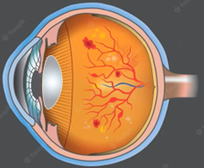
OBJECTIVE
To classify the severity of Diabetic Retinopathy (DR) which causes severe vision loss to diabetic patient. It is classified based on Deep Learning by using Large Fundus Image Dataset.

Slide 3
INTRODUCTION
Diabetic retinopathy (DR) in the leading cause of avoidable visual loss in people of working age in developed countries.
The disease’s global prevalence in estimated to rise at an exponential rate, reaching 529 million by 2030.
This is concerning for Worldwide National Health care, as affects people's ability to work, putting the economy in jeopardy.

Slide 4
LITERATURE SURVEY
TITLE | DESCRIPTION | PUBLICATION
Deep convolutional neural networks | Diabetic Retinopathy (DR) is a chronic eye disease, commonly found in elderly people (age 50 or above), and can cause severe visual impairments or even blindness if not treated at an early stage | Gonzalez, R.C on 2018 (IEEE Signal Process)
Diabetic Retinopathy | Among these 387 million people, 93 million people are with positive DR. | Shukla, U.V.; Tripathy, K on 2022(https://www.ncbi.nlm.nih.gov)
A Deep Learning Based Pipeline for Image Grading of Diabetic Retinopathy. | The developed techniques covered conventional image processing machine learning, optimization, deep learning, and now explainable models. Wang Yu, proposed a research [6] framework | Wang, Y.; Wang, G.A.; Fan, W.; Li, J on 2018(International Conference, ICSH, Shenzhen, China)

Slide 5
TITLE | DESCRIPTION | PUBLICATION
Diabetic Retinopathy Image Classification Using Support Vector Machine. | Used a different approach that focused only on important features and exudates on retina to predict the condition of the disease, since they play a significant role in detecting the severity of disease. | Behera, M.K.; Chakravarty, S on 2020 (https://ieeexplore.ieee.org)
Diabetic Retinopathy Stages Classification using Improved Deep Learning. | Worked on basic CNN architecture of VGG and achieved an accuracy of 99.9% using the Messidor dataset and 98% accuracy using the Kaggle dataset. | Sudarmadji, P.W.; Pakan, P.D.; Dillak, R.Y. on 2020 (https://dx.doi.org)
Automated Diabetic Retinopathy Grading using Resnet. | Pre-processed the images using normalization and augmentation, followed by feature extraction. | Elswah, D.K.; Elnakib, A.A.; Moustafa, H.E. on 2020 (https://ieeexplore.ieee.org)

Slide 6
PROBLEM DEFINITION
Diabetic Retinopathy (DR) is a chronic eye disease, commonly found in elderly people (age 50 or above), and can cause severe visual impairments or even blindness if not treated at an early stage [1].
DR is caused by the blood vessels rupturing due to high blood sugar levels.
These leaky vessels produce fluid clots and oxygen deficiency, leading to severe visual impairments
However, the progression of the disease can be reduced if diagnosed at an early stage.

Slide 7
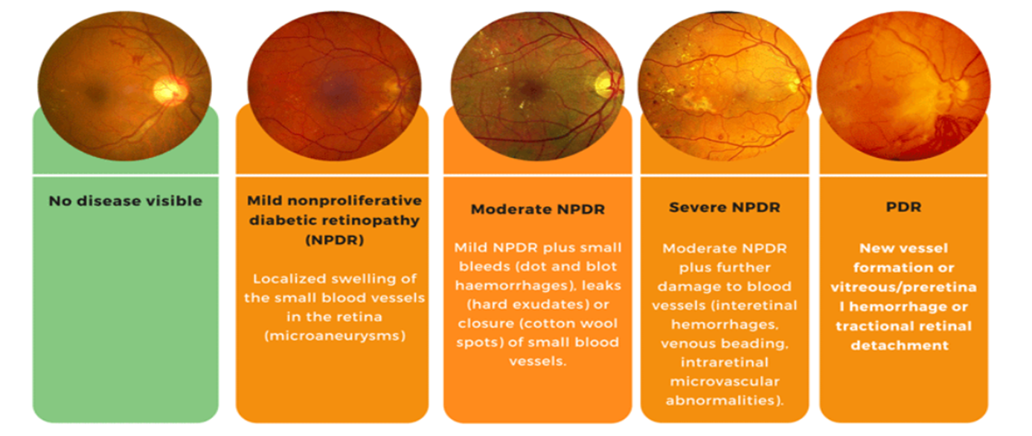
TYPES 0F DIABETIC RETINOPATHY
DR is classified into two types, i.e., Proliferative and Non Proliferative Diabetic Retinopathy (NPDR).
PDR which results in complete blindness.
NPDR is graded into three stages ,
(i)Mild (ii)Moderate (iii)Severe NPDR
Severe NPDR is transmitted into PDR due to lack of proper and timely treatment.

Slide 8
BLOCK DIAGRAM OF PROPOSED METHOD
INPUT
PREPROCESSING
SEGMENTATION
CLASSIFICATION
OUTPUT

Slide 9
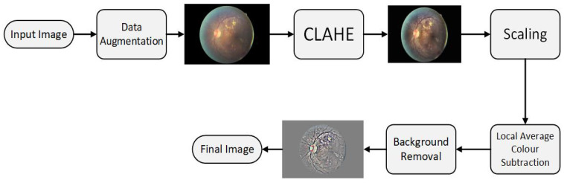
PRE PROCESSING PHASE
DATA AUGMENTATION – Flipping to 90 degree, rotating image by (0,180) degree.
CLAHE – Algorithm used Contrast Limited Adaptive Histogram Equalization.
SCALING – Pixel Size [300 PIXELS OR 500PIXELS].
COLOUR NORMALIZATION AND BACKGROUND REMOVAL – Removed Background and Unwanted Details.
Gray Scale Mapping – Local Average to 50% Gray Scale image.
Resizing – Finally we Resized to 256 x 256.

Slide 10
SEGMENTATION
CONVOLUTION
MAXPOOLING LAYER
ACTIVATION LAYER
DROUPOUT LAYER
FULLY CONNECTED LAYER
FEATURE VECTOR

Slide 11
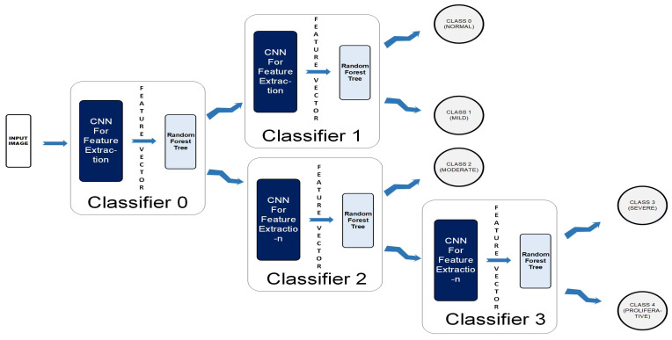
CLASSIFICATION
A Colored Fundus image(256 x 256 x3) is fed to the CCN as input.
The output map is sequentially forwarded from the previous one to the next four classifiers within the CCN.
The new test color fundus image moves node-wise and ultimately reaches one of the five leaf nodes (terminal nodes) for final decision-making.
Finally, it can be classified among one the five classes: Normal, Mild, Moderate, Severe, and Proliferative.

Slide 12
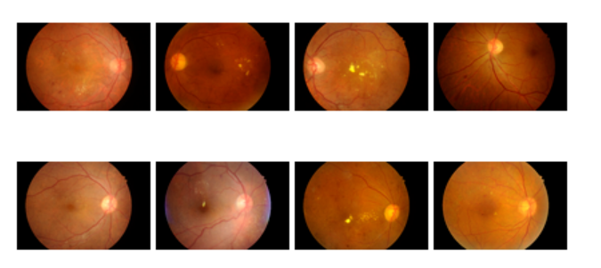
TOOL
MATLAB(2021)
DATASET
Two Public Dataset INDIAN DIABETIC RETINOPATHY IMAGE DATASET(IDRiD) and MESSIDOR DATABASE
INDIAN DIABETIC RETINOPATHY IMAGE DATASET(IDRiD) Contains 516 Retina images
MESSIDOR DATABASE Contains 1748 Retina images
SAMPLE DATASET

Slide 13
CONCLUSION

Slide 14
REFERENCES:
1. Taylor, R. & Batey, D. Handbook of Retinal Screening in Diabetes: Diagnosis and Management. Wiley (2021).
2. Wang, F., Casalino, L. P. & Khullar, D. Deep Learning in Medicine-Promise, Progress, and Challenges. JAMA Intern Med. (2020).
3. Guan, M. Y., Gulshan, V., Dai, A. M. & Hinton, G. E. Who Said What: Modeling Individual Labelers Improves Classification. arXiv e-prints., https://ui.adsabs.harvard.edu/\#abs/2017arXiv170308774G. (Accessed March 01, 2020).

